Slide 1
TICKETING SYSTEM using Blockchain Technology
Team Details
A.Rakshith Reddy (20EG105505)
K.Sravan Kumar (20EG105527)
M.Yashwanth Reddy (20EG105533)
Project Supervisor
Mrs. P. Vinayasree
(Assistant Professor, Department of CSE, Anurag University)

Slide 2
Introduction
Are you sick and weary of secondary market uncertainties, bogus duplication, and ticket scalping? We are thrilled to present a ground-breaking blockchain-based ticketing system. Buying, selling, and managing your event tickets is made simple, transparent, and safe with the help of this cutting-edge platform.
Blockchain Ticketing: What Is It?
Blockchain is a distributed ledger that keeps track of transactions via a computer network. Several benefits are provided by this technology for ticketing systems:
Unmatched Security: Tickets are kept on the blockchain as distinct, unchangeable tokens, removing the possibility of fraud or duplication.
Transparency for All: Each and every transaction is documented on the blockchain, giving each ticket a full and authenticated history.
Fair and Secure Resale: By eliminating scalping and guaranteeing fair pricing, the platform makes ticket resale transparent and safe.
Applications:
Enhanced Security and Reduced Fraud
Transparent Secondary Market
Improved Fan Engagement
Streamlined Ticketing Process

Slide 3
Problem Statement
The many issues with our current ticketing system annoy event planners as well as attendees. Ticket counterfeiting and scalping result in lost profits for organizers and inflated or even fraudulent prices for attendees. Reselling tickets via unofficial means is risky since there's no way to know if they're authentic and little to lose if they aren't. From purchase until admission, the entire procedure may be drawn out, tedious, and fraught with needless costs. The tickets are only passes for access; they don't come with any extra benefits or ways for attendees to interact with the event. Imagine a situation where a fan has been saving money for their favorite band's performance for months, only to discover at the venue that their ticket is a fake. There is a great deal of disappointment and frustration. This is but one illustration of the issues ailing the present framework. We require a new ticketing system that puts efficiency, openness, and security first. In addition to safeguarding attendees and organizers, this will make the event run more smoothly and happily for all.
Everyone finds the present ticketing system to be a pain. Inflated pricing and phony tickets put fans at risk of frauds. Reselling has no assurance of authenticity, thus it's a risk. The procedure is cumbersome, sluggish, and expensive. Tickets have no additional value; they are merely tickets for entry. Imagine putting money down for a concert, only to have your phony ticket confiscated. We require an improved system that is safe, open, and effective and that helps organizers and spectators alike.

Slide 4
Proposed Method
Imagine a secure online ticket vault. This vault, built on blockchain technology, eliminates the middleman and creates unique digital tickets for each event. These tickets can't be forged and are easily transferred between fans directly on the platform. Fans win with lower fees and a safe way to resell tickets. Event organizers benefit from reduced fraud and the ability to connect directly with fans through the platform.
To ensure ticketing system on blockchain networks, we propose several strategies tailored to enhance security, efficiency, and trustworthiness:
Blockchain Ticketing Platform: Clear Secondary Market: Using the blockchain technology, enable a safe secondary market for tickets. With smart contract-enforced regulations, users may resell tickets and avoid scalping while guaranteeing fair pricing.
Smart Contracts for Ticketing: Make smart contracts that run on their own to control the ticketing procedure. These agreements will specify the characteristics of the tickets, oversee their issue, transfer, and resale, and implement the regulations set forth by the event organizer (such as price caps and resale limitations).
Secure User Management: Provide a safe user management platform for both event planners and participants. On the platform, users may register, buy tickets with bitcoin or conventional payment methods, and manage their ticket accounts.
Transparent Secondary Market: Create a safe secondary ticket market by utilizing the blockchain technology. With smart contract-enforced regulations, users may resell tickets and avoid scalping while guaranteeing fair pricing.

Slide 5
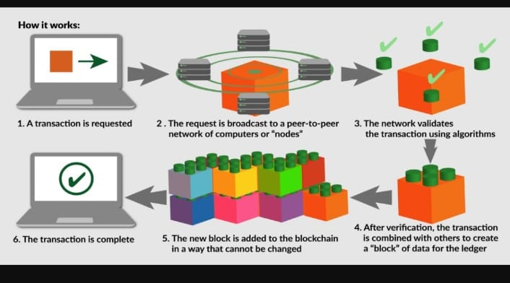
Proposed Method Illustration
Login with metamask
creates unique tickets
Fans buy tickets with ease
Blockchain Network Validation
Transaction Confirmation
Interoperability and Integration
Continuous Monitoring and Incident Response

Slide 6
Experiment Environment
HARDWARE SPECIFICATION
Processor : i5 Processor, Ryzen 5 above
Ram : 8 Gb and above
Hard Disk : 256 GB.
GPU : GTX 1650
SOFTWARE SPECIFICATION
Operating System : Windows.
Programming Language : JavaScript, Solidity, Node.js
IDE : VS code
Blockchain dev framework : web3.js, Ganache

Slide 7
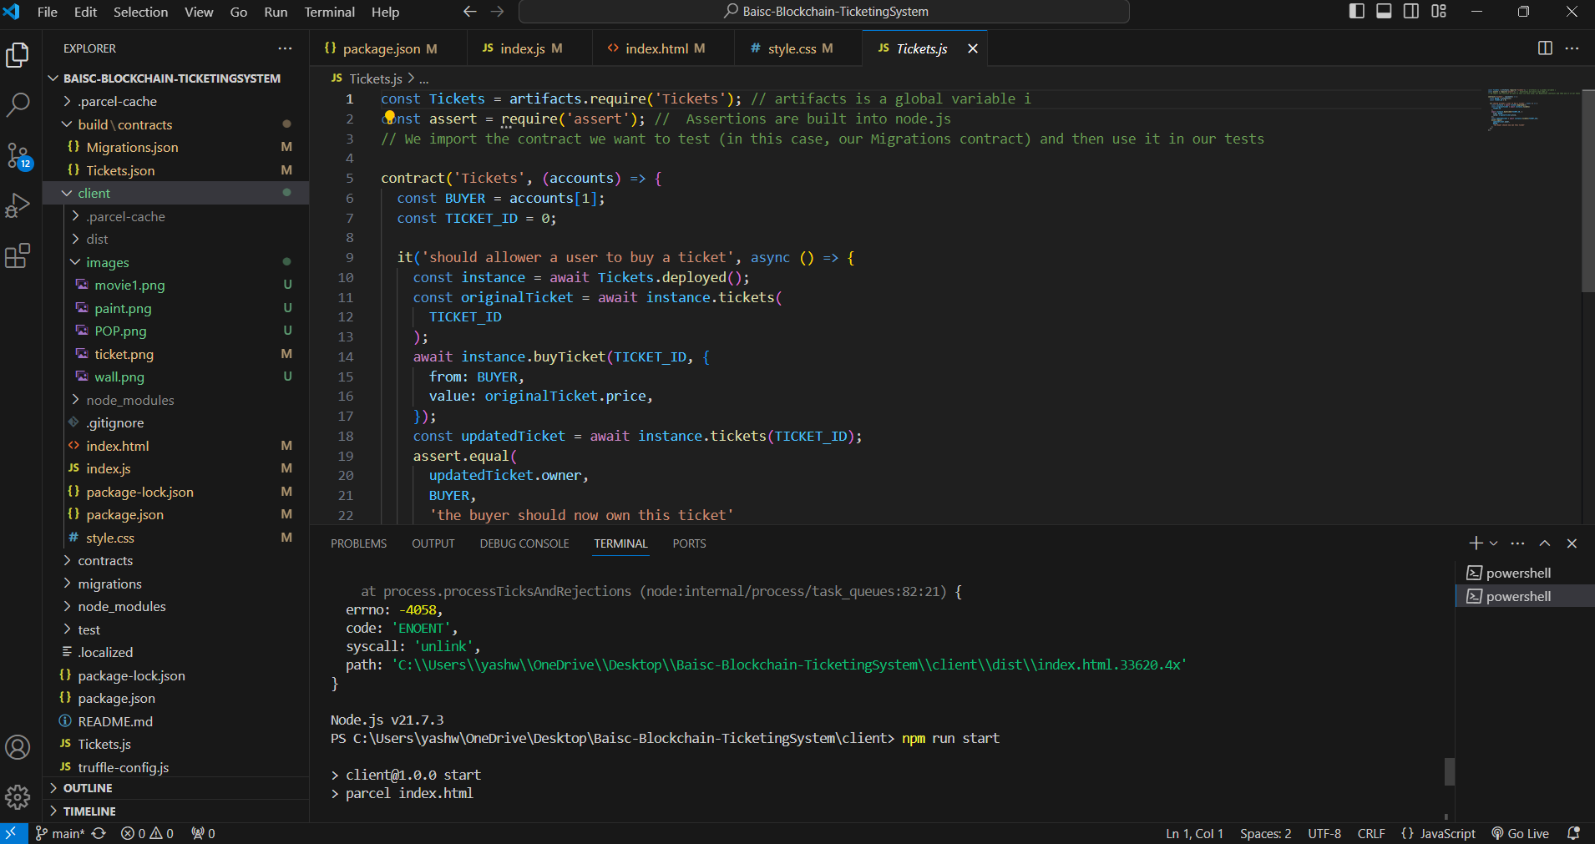
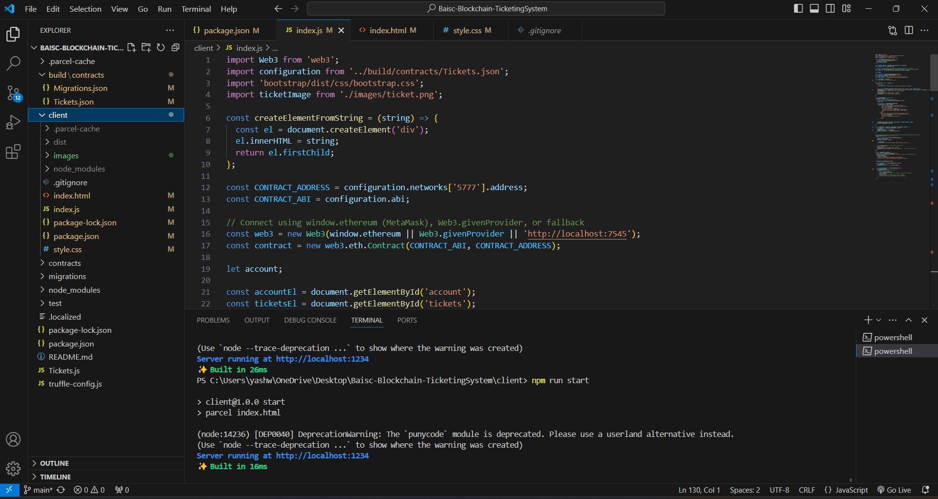
Experiment Screen shorts

Slide 8
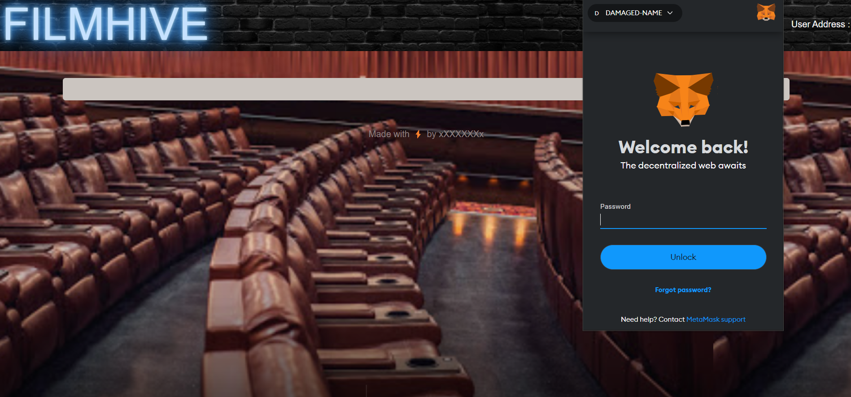
Experiment Results

Slide 9
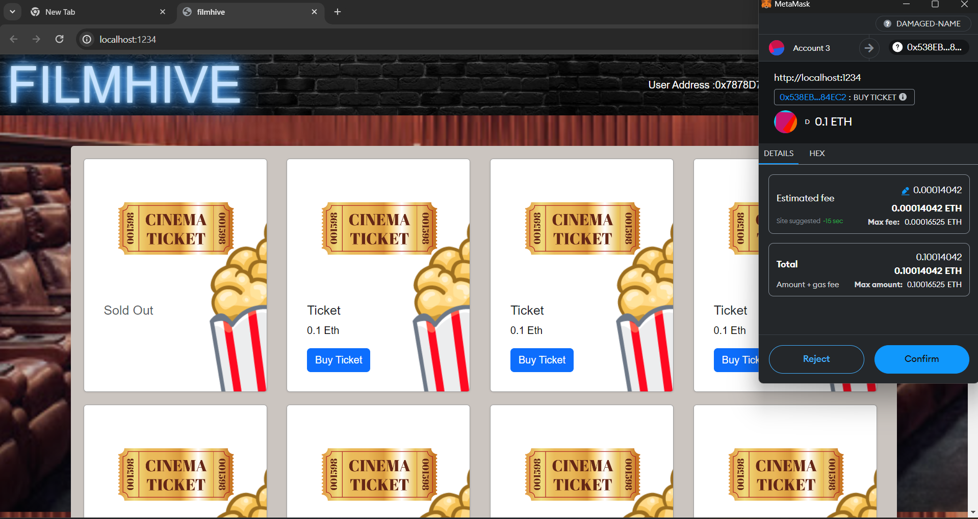
Experiment Results

Slide 10
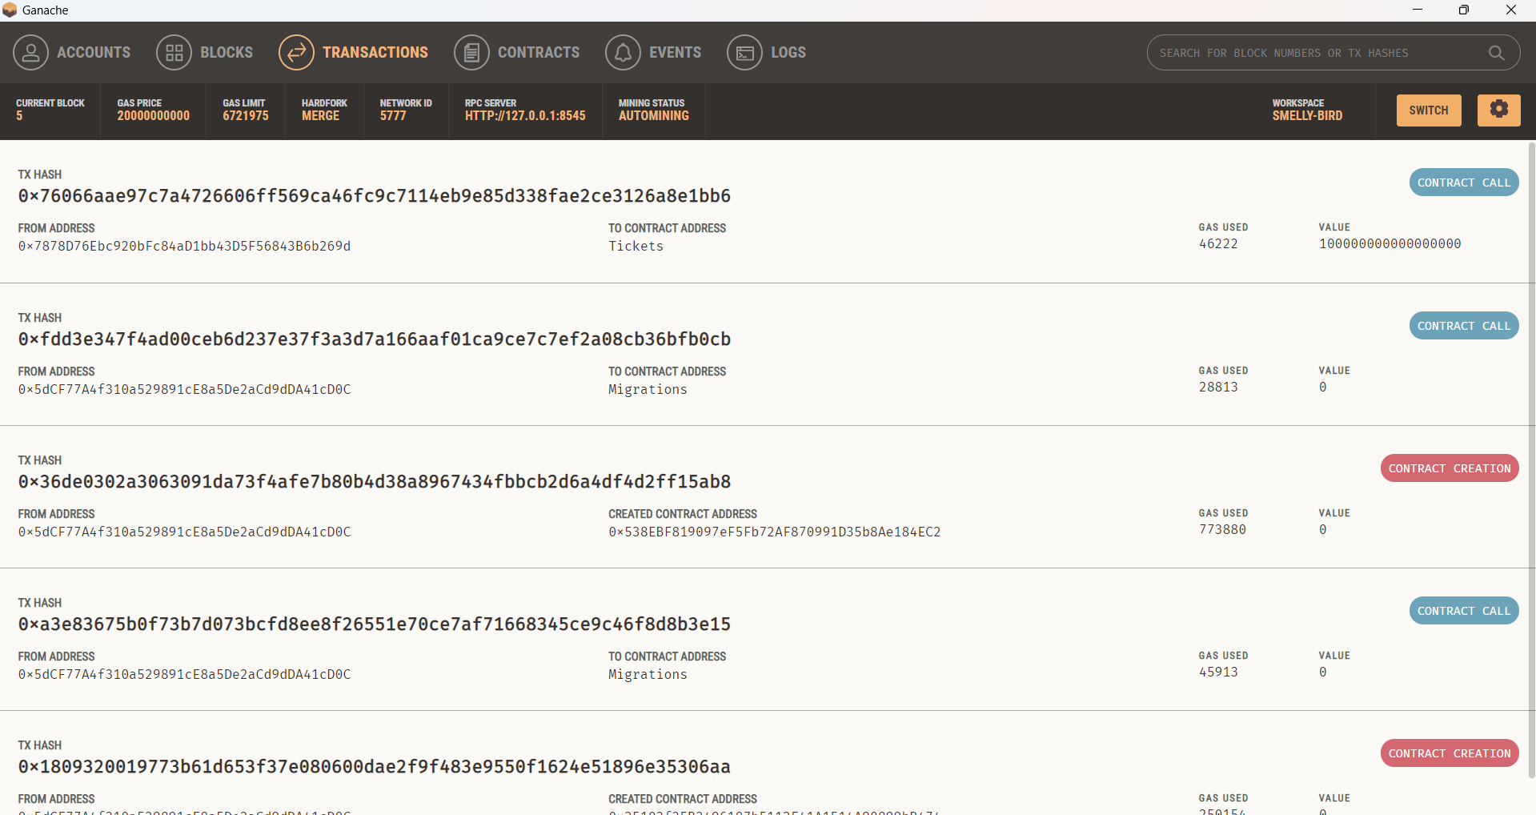
Experiment Results

Slide 11
Findings
Systems for blockchain-based ticketing resemble safe digital ticket vaults. For those who plan events as well as those who attend concerts, this technology presents fascinating opportunities. It means that spectators will not have to worry about fraudulent tickets or unfair scalping. Tickets can be sold in a transparent, safe, and resale market on blockchain that keeps prices closer to face value. Furthermore, see your ticket as more than simply a pass for admittance; it might even grant you access to special content or the ability to vote in events to come! In addition, event planners gain from lower fraud and a channel for communicating with attendees directly. There are certain obstacles to overcome, though. The key is to scale this technology for large-scale events while maintaining user-friendly interfaces. Laws are also catching up, so certain changes may be needed to integrate blockchain technology with current process. Notwithstanding these difficulties, blockchain ticketing has the power to completely transform the market and give consumers a safer, more seamless experience.

Slide 12
Justification
Because of the chaos in our existing ticketing system, fans are at risk of fraud and exorbitant charges. Blockchain-based ticketing presents a potent remedy. Envision a safe, digital safe where tickets are unforgeable. By using smart contracts to stop scalping, this system guarantees fair prices and guards against fraud against fans. However, things improve! These permits can be more than just admission tickets. Fans and events can engage more deeply when they can access exclusive content, discounts, or even voting privileges. Reduced fraud and a platform for direct audience interaction help event organizers as well. There are challenges to be solved, such as making this system user-friendly and scalable for big events. Nonetheless, there is no denying blockchain ticketing's promise. It promises an efficient, transparent, and safe future for ticket purchasing that will benefit event planners as well as attendees.

